Slide 1
Kinect Natural User Interfaces
Body Tracking with Kinect
Section 3.1

Slide 2
Topics
People tracking with Kinect
Kinect skeleton data
Setting up the Kinect skeleton tracking
Skeletons and joints
Drawing a skeleton in XNA

Slide 3
Kinect Skeleton Tracking
The Kinect sensor provides depth information that is used by the Kinect SDK to track the position of people standing in front of the sensor
The software can track up to 6 people
2 tracked in detail
4 tracked by position only

Slide 4
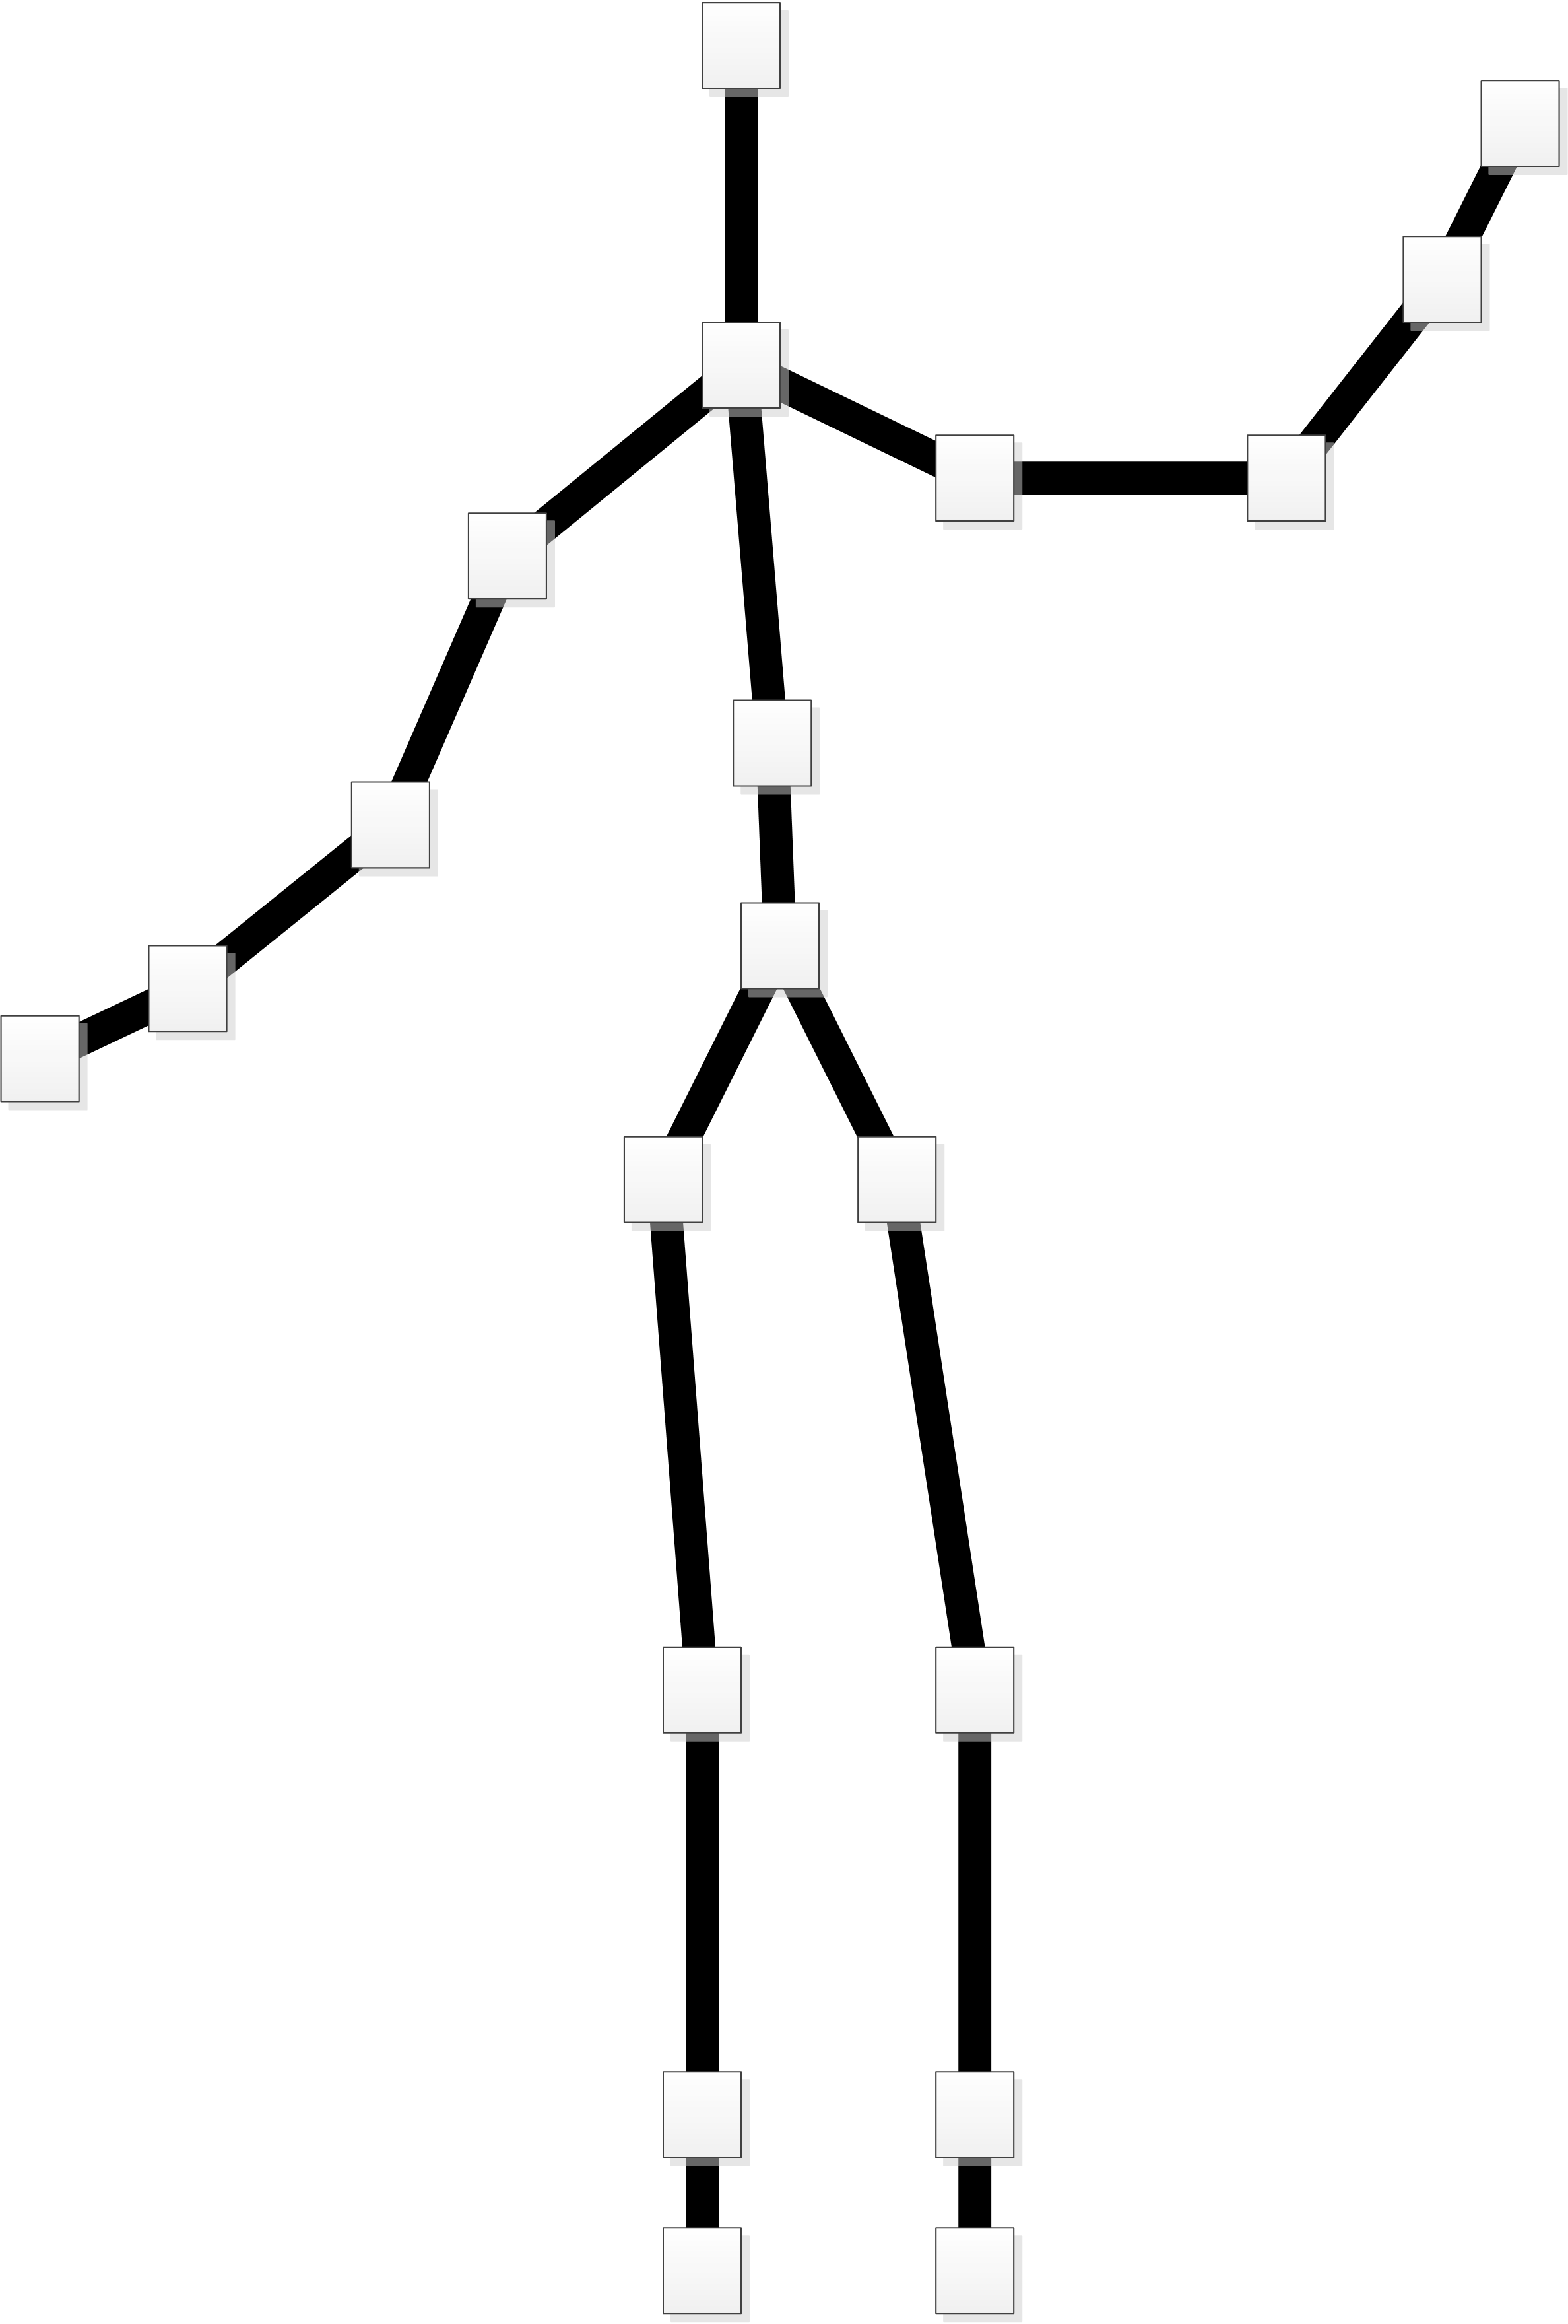
Kinect Skeleton Data
A Kinect skeleton is made up of 19 bones and 20 joints
Each joint is positioned in 3D space relative to the Kinect sensor

Slide 5
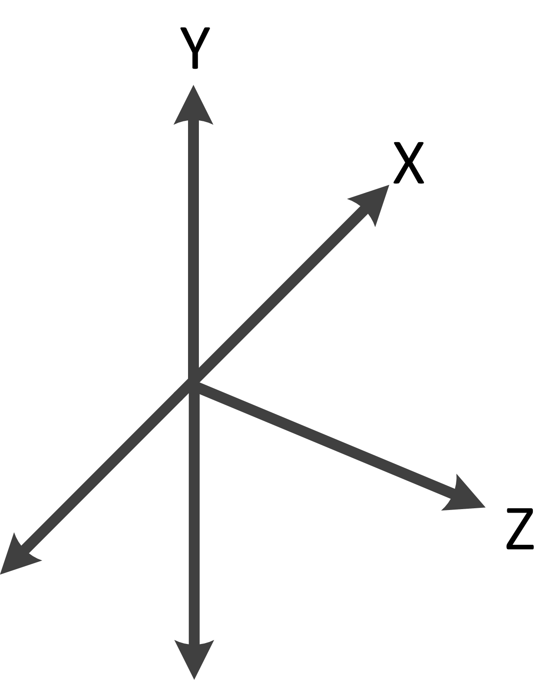
Skeleton coordinates
The position of each joint is given as an offset from the Kinect sensor
X is left-right
Y is up-down
Z is away from the sensor
The values are given in mm

Slide 6
Starting Tracking
myKinect = KinectSensor.KinectSensors[0];
myKinect.SkeletonStream.Enable();
The skeleton tracking behaviour is selected in the same way as the depth and colour cameras
A program can use skeleton tracking in conjunction with the other Kinect sensors

Slide 7
Skeleton Tracking Events
myKinect.SkeletonFrameReady += new EventHandler<SkeletonFrameReadyEventArgs> (myKinect_SkeletonFrameReady);
As with the previous sensors, the Kinect can create an event when it has new skeleton data
The event hander will deal with the new skeleton data
The event is fired when the Kinect SDK has finished processing a depth frame

Slide 8
The Skeletons storage
Skeleton [] skeletons = null;
The skeleton data event handler will not be able to draw the skeleton
In an XNA game the drawing is performed when the Draw method is called
Instead the event handler will find skeleton data and store it in the game for use when Draw runs

Slide 9
Finding a skeleton
void myKinect_SkeletonFrameReady(object sender, SkeletonFrameReadyEventArgs e)
{
using (SkeletonFrame frame = e.OpenSkeletonFrame()) {
if (frame != null) {
skeletons = new Skeleton[frame.SkeletonArrayLength];
frame.CopySkeletonDataTo(skeletons);
}
}
}
This code copies all the skeleton data from the event into the skeletons array

Slide 10
Finding a skeleton
void myKinect_SkeletonFrameReady(object sender, SkeletonFrameReadyEventArgs e)
{
using (SkeletonFrame frame = e.OpenSkeletonFrame()) {
if (frame != null) {
skeletons = new Skeleton[frame.SkeletonArrayLength];
frame.CopySkeletonDataTo(skeletons);
}
}
}
The argument to the method contains information about the skeleton data found

Slide 11
Finding a skeleton
void myKinect_SkeletonFrameReady(object sender, SkeletonFrameReadyEventArgs e)
{
using (SkeletonFrame frame = e.OpenSkeletonFrame()) {
if (frame != null) {
skeletons = new Skeleton[frame.SkeletonArrayLength];
frame.CopySkeletonDataTo(skeletons);
}
}
}
The SkeletonFrame object holds skeleton information

Slide 12
Finding a skeleton
void myKinect_SkeletonFrameReady(object sender, SkeletonFrameReadyEventArgs e)
{
using (SkeletonFrame frame = e.OpenSkeletonFrame()) {
if (frame != null) {
skeletons = new Skeleton[frame.SkeletonArrayLength];
frame.CopySkeletonDataTo(skeletons);
}
}
}
If we have new skeleton information an array is created and the data copied into it

Slide 13
Finding a skeleton
void myKinect_SkeletonFrameReady(object sender, SkeletonFrameReadyEventArgs e)
{
using (SkeletonFrame frame = e.OpenSkeletonFrame()) {
if (frame != null) {
skeletons = new Skeleton[frame.SkeletonArrayLength];
frame.CopySkeletonDataTo(skeletons);
}
}
}
This pattern is exactly the same as the one used for depth and video data

Slide 14
Draw method
protected override void Draw(GameTime gameTime) { GraphicsDevice.Clear(Color.CornflowerBlue);
spriteBatch.Begin();
if ( skeletons != null )
foreach ( Skeleton s in skeletons)
if (s.TrackingState == SkeletonTrackingState.Tracked)
drawSkeleton(s, Color.White);
spriteBatch.End();
base.Draw(gameTime); }
Draw calls drawSkeleton to do the drawing

Slide 15
Program operation
When the game is running the Update and Draw methods are called 60 times a second
These can read the Skeletons value
The myKinect_SkeletonFrameReady method is called whenever new skeleton data is ready for processing by the game
This will set the Skeletons value
The Draw method calls drawSkeleton to draw the skeleton

Slide 16
Sharing skeleton data
skeletons
myKinect_SkeletonFrameReady
Draw
The skeleton processing and the Draw method are running independently
One produces values and the other consumes

Slide 17
Skeletons and joints
The skeleton information contains 20 joint values
Each joint value contains the position of the joint and information about the quality of the data
NotTracked – not visible to be tracked
Inferred – calculated based on other joints
Tracked – visible and tracked

Slide 18
The Joints collection
Joint head = activeSkeleton.Joints[JointType.Head];
A skeleton contains a collection of joints that define its position
The collection can be indexed to find the required Joint
The JointType class holds values that represent the joint types
Above is a statement that gets the head joint from the active skeleton

Slide 19
Drawing individual “bones”
drawBone(skel.Joints[JointType.Head], skel.Joints[JointType.ShoulderCenter], col);
The drawBone method draws a bone that links two joints together
It is supplied with the colour to draw the bone
By making the appropriate calls to drawBone the program can draw the entire skeleton

Slide 20
Joint positions and the screen
The position of each joint is given in three dimensions (X, Y and Z)
The 3D position of a joint must be mapped into 2D coordinates to set the position of the joint on the screen
The Kinect SDK provides a method that will take 3D values and return the 2D position in the colour video image of that joint

Slide 21
MapSkeletonPointToColor
ColorImagePoint headPos = myKinect.MapSkeletonPointToColor(
head.Position,
ColorImageFormat.RgbResolution640x480Fps30);
The method takes the position of a joint and works out the x and y positions in the colour image frame of that point
The method is told the target resolution
The result is returned as a value of type ColorImagePoint

Slide 22
The story so far…
The program wants to draw the skeleton by drawing lines between the joint positions
It needs to know the start and end points of the lines it will draw
The positions of the joints are given in 3D in front of the sensor
The MapSkeletonPointToColor method takes a 3D position and returns the distance across and down the colour frame

Slide 23
Finding the draw position
Vector2 j1V = new Vector2(j1P.X, j1P.Y);
This statement creates a new vector that gives the drawing position for the joint
It multiplies the width and height of the screen by the joint position values returned by MapSkeletonPointToColor

Slide 24
The drawBone method
void drawBone(Joint j1, Joint j2, Color col) { ColorImagePoint j1P = myKinect.MapSkeletonPointToColor( j1.Position,
ColorImageFormat.RgbResolution640x480Fps30);
Vector2 j1V = new Vector2(j1P.X, j1P.Y);
ColorImagePoint j2P = myKinect.MapSkeletonPointToColor(
j2.Position,
ColorImageFormat.RgbResolution640x480Fps30);
Vector2 j2V = new Vector2(j2P.X, j2P.Y);
drawLine(j1V, j2V, col); }
This draws a bone

Slide 25
The drawBone method
void drawBone(Joint j1, Joint j2, Color col) { ColorImagePoint j1P = myKinect.MapSkeletonPointToColor( j1.Position,
ColorImageFormat.RgbResolution640x480Fps30);
Vector2 j1V = new Vector2(j1P.X, j1P.Y);
ColorImagePoint j2P = myKinect.MapSkeletonPointToColor(
j2.Position,
ColorImageFormat.RgbResolution640x480Fps30);
Vector2 j2V = new Vector2(j2P.X, j2P.Y);
drawLine(j1V, j2V, col); }
Convert the position into a 2D value

Slide 26
The drawBone method
void drawBone(Joint j1, Joint j2, Color col) { ColorImagePoint j1P = myKinect.MapSkeletonPointToColor( j1.Position,
ColorImageFormat.RgbResolution640x480Fps30);
Vector2 j1V = new Vector2(j1P.X, j1P.Y);
ColorImagePoint j2P = myKinect.MapSkeletonPointToColor(
j2.Position,
ColorImageFormat.RgbResolution640x480Fps30);
Vector2 j2V = new Vector2(j2P.X, j2P.Y);
drawLine(j1V, j2V, col); }
Make a vector from it

Slide 27
The drawBone method
void drawBone(Joint j1, Joint j2, Color col) { ColorImagePoint j1P = myKinect.MapSkeletonPointToColor( j1.Position,
ColorImageFormat.RgbResolution640x480Fps30);
Vector2 j1V = new Vector2(j1P.X, j1P.Y);
ColorImagePoint j2P = myKinect.MapSkeletonPointToColor(
j2.Position,
ColorImageFormat.RgbResolution640x480Fps30);
Vector2 j2V = new Vector2(j2P.X, j2P.Y);
drawLine(j1V, j2V, col); }
Repeat for the other joint

Slide 28
The drawBone method
void drawBone(Joint j1, Joint j2, Color col) { ColorImagePoint j1P = myKinect.MapSkeletonPointToColor( j1.Position,
ColorImageFormat.RgbResolution640x480Fps30);
Vector2 j1V = new Vector2(j1P.X, j1P.Y);
ColorImagePoint j2P = myKinect.MapSkeletonPointToColor(
j2.Position,
ColorImageFormat.RgbResolution640x480Fps30);
Vector2 j2V = new Vector2(j2P.X, j2P.Y);
drawLine(j1V, j2V, col); }
Draw the line that links the bones

Slide 29
Drawing lines in XNA
We now have the start and end position of the bone we want to draw on the screen
Unfortunately XNA does not provide a line drawing method
We have to provide our own line drawing routine
The easiest way to do this is to scale a texture to turn it into a long thin line

Slide 30
The dot texture
Texture2D lineDot;
The lineDot texture is a 4x4 white texture which is transformed into a line with the required direction and length
Remember that the SpriteBatch Draw method can rotate and scale textures
The dot can also be drawn in different colours
You can get interesting effects by drawing other textures

Slide 31
The drawLine method
void drawLine(Vector2 v1, Vector2 v2, Color col)
{
Vector2 diff = v2 - v1;
Vector2 scale = new Vector2(1.0f, diff.Length() / lineDot.Height);
float angle = (float)(Math.Atan2(diff.Y, diff.X)) – MathHelper.PiOver2;
Vector2 origin = new Vector2(0.5f, 0.0f);
spriteBatch.Draw(lineDot, v1, null, col, angle, origin, scale, SpriteEffects.None, 1.0f);
}
We can use this to draw a line

Slide 32
The drawLine method
void drawLine(Vector2 v1, Vector2 v2, Color col)
{
Vector2 diff = v2 - v1;
Vector2 scale = new Vector2(1.0f, diff.Length() / lineDot.Height);
float angle = (float)(Math.Atan2(diff.Y, diff.X)) – MathHelper.PiOver2;
Vector2 origin = new Vector2(0.5f, 0.0f);
spriteBatch.Draw(lineDot, v1, null, col, angle, origin, scale, SpriteEffects.None, 1.0f);
}
Create a vector that joins the two points

Slide 33
The drawLine method
void drawLine(Vector2 v1, Vector2 v2, Color col)
{
Vector2 diff = v2 - v1;
Vector2 scale = new Vector2(1.0f, diff.Length() / lineDot.Height);
float angle = (float)(Math.Atan2(diff.Y, diff.X)) – MathHelper.PiOver2;
Vector2 origin = new Vector2(0.5f, 0.0f);
spriteBatch.Draw(lineDot, v1, null, col, angle, origin, scale, SpriteEffects.None, 1.0f);
}
Create a scale factor that will make the dot the same length as the line

Slide 34
The drawLine method
void drawLine(Vector2 v1, Vector2 v2, Color col)
{
Vector2 diff = v2 - v1;
Vector2 scale = new Vector2(1.0f, diff.Length() / lineDot.Height);
float angle = (float)(Math.Atan2(diff.Y, diff.X)) – MathHelper.PiOver2;
Vector2 origin = new Vector2(0.5f, 0.0f);
spriteBatch.Draw(lineDot, v1, null, col, angle, origin, scale, SpriteEffects.None, 1.0f);
}
Calculate the angle of rotation of the line

Slide 35
The drawLine method
void drawLine(Vector2 v1, Vector2 v2, Color col)
{
Vector2 diff = v2 - v1;
Vector2 scale = new Vector2(1.0f, diff.Length() / lineDot.Height);
float angle = (float)(Math.Atan2(diff.Y, diff.X)) – MathHelper.PiOver2;
Vector2 origin = new Vector2(0.5f, 0.0f);
spriteBatch.Draw(lineDot, v1, null, col, angle, origin, scale, SpriteEffects.None, 1.0f);
}
Define the origin for the rotation of the line

Slide 36
The drawLine method
void drawLine(Vector2 v1, Vector2 v2, Color col)
{
Vector2 diff = v2 - v1;
Vector2 scale = new Vector2(1.0f, diff.Length() / lineDot.Height);
float angle = (float)(Math.Atan2(diff.Y, diff.X)) – MathHelper.PiOver2;
Vector2 origin = new Vector2(0.5f, 0.0f);
spriteBatch.Draw(lineDot, v1, null, col, angle, origin, scale, SpriteEffects.None, 1.0f);
}
Draw the line on the screen

Slide 37
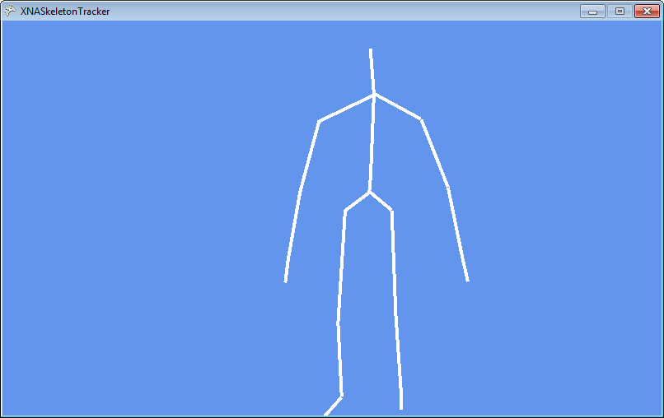
Demo
1 Kinect parrot
Notes:
For this demonstration to work you must have installed the Kinect for Windows SDK. You must also have a Kinect sensor plugged into the USB Port on your computer.
Start Visual Studio 2010
Open the project XNASkeletonTracker in the 01 Skeleton Display demo folder.
Run the program by pressing F5.
The program will start running.
Get a volunteer to stand in front of the sensor. It should display their skeleton on the screen.
Wait for a round of applause.
Stop the program and exit Visual Studio.

Slide 38
Summary
The Kinect for Windows SDK can track up to six people, 2 in detail
The position of each person is broken down into 20 joints
Each joint is assigned a position in the 3D space in front of the sensor
The joint position can be directly observed or inferred by the software
The Kinect SDK provides a method that can convert 3D joint positions into 2D offsets into the depth frame
These 2D values can be used for drawing the skeleton

